Slide 1


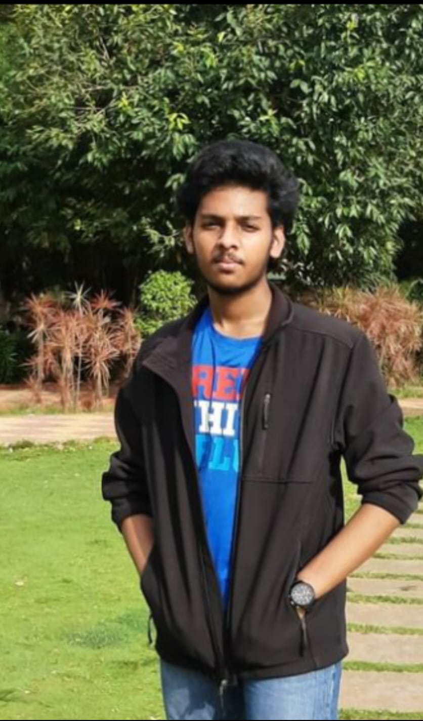
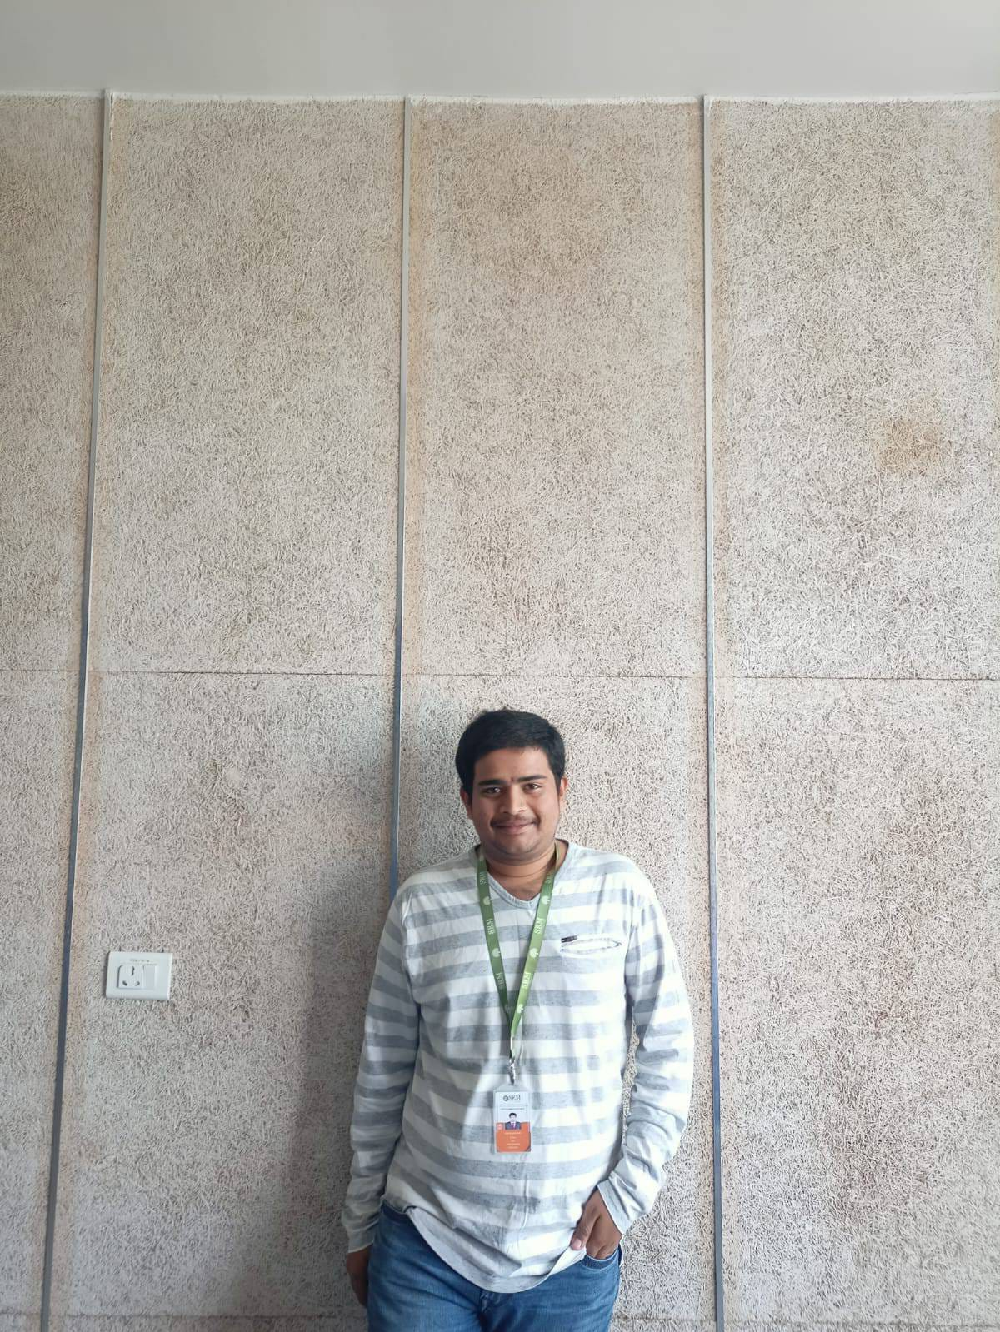
A 4-Wheeled detective Vehicle
Student Names , Registered Numbers
D. Yuvaraj 2. P.PrudhviKrishna 3. N.Lenyadri
AP20110020001 AP20110020021 AP20110020042
Minor Project Submitted to
Dr.K.A.Sunitha
Course Code/Title:ECE349
Microprocessors & Microcontrollers
Department of Electronics and Communication Engineering

Slide 2
Abstract
ABSTRACT: - The opportunity for future engineers for direct hands-on work on projects and the liberty of trying their solutions and applying personal ideas with a large variety of electronic components, will lead to progress in everyday life for future generations.
In this paper, we present a remote-controlled ROV (Remotely Operated Vehicle) based on Arduino ATMega328p microcontroller which acquired the sensors data and we will control the direction of the vehicle according to the path and also acceleration.
The MQ series of gas sensors use a small heater inside with an electrochemical sensor. They are sensitive to a range of gasses and are used indoors at room temperature. The MQ-2 Gas Sensor module is useful for detecting in the home and industry. It can detect LPG, i-butane, propane, methane, alcohol, hydrogen, and smoke.
Piezo buzzers are simple devices that can generate basic beeps and tones. They work by using a piezo crystal, a special material that changes shape when voltage is applied to it. If the crystal pushes against a diaphragm, like a tiny speaker cone, it can generate a pressure wave that the human ear picks up as sound.
The Power input is 5v-12v after that the MQ-2 sensor starts working then we are sending the Remotely operated vehicle to the place where we want to test if the dangerous gases are present or not. we placed two LEDs green and red. If there are no gases present it glows green, if gases are present glows red and the piezo buzzer beeps a sound for a warning.
Department of Electronics and Communication Engineering

Slide 3
LITERETURE SURVEY
Reference No. | Publication /patent title | Advantages | Disadvantages
[1]. | The ROV communication and control | This ROV is Used for Expeditions purposes it has high-quality cameras and sensors are precise in outputs | The ROV is useful in some terrestrial places like sand areas. Only for purpose of Expeditions
[2]. | Supervisory control system for the Jason ROV | This is an under water ROV which has a wide range and high powered cameras and arms to do research in water ecosystems and wire operated also | This ROV is only useful in water Ecosystems. It will not be useful in terrestrial operation.
Novelty
We are creating this project with the inspiration of ROUV we are furthermore improvising it to work on different types of landscapes. It is a unique one in the field of building ROV.
Department of Electronics and Communication Engineering

Slide 4
Block Diagram
5V POWER SOURCE
POWER SOURCE FOR CAR
CAMERA
ARDUINO UNO ATMEGA 328P
REMOTE CONTROL MODULE WITH WIFI
RED LED
MQ-2 GAS SENSOR
MQ-2 GAS SENSOR
GREEN LED
REMOTE CONTROL
MOBILE APPLICATION CAMERA VIEW
PIEZO BUZZZER
Department of Electronics and Communication Engineering

Slide 5
AIM: OBJECTIVES:
AIM: - We are making this project to make use of this thing to detect harmful gases in dangerous locations like Fire accidental places, mining places, and geological explorations in those cases to avoid human presence and also to reduce the deaths of people in those types of dangerous locations in the use to know whether there is a case of any gas leakage etc.,
Objectives:
To sense different types of harmful gases which are harmful to humans we are using MQ2 sensor.
To see in which direction the vehicle is moving we are using camera.
To check when there are no harmful gases we are using a Green LED.
To check the harmful gases we have installed a piezo buzzer for sound and a Red LED for visibility.
Department of Electronics and Communication Engineering

Slide 6
Flow chart of the Program
Start
MQ-2 DATA INPUT
ARDUINO UNO ATMEGA 328P analysing information
There is no gas glow green led
If gas is detected glow RED led and sound the buzzer
Stop
Department of Electronics and Communication Engineering

Slide 7
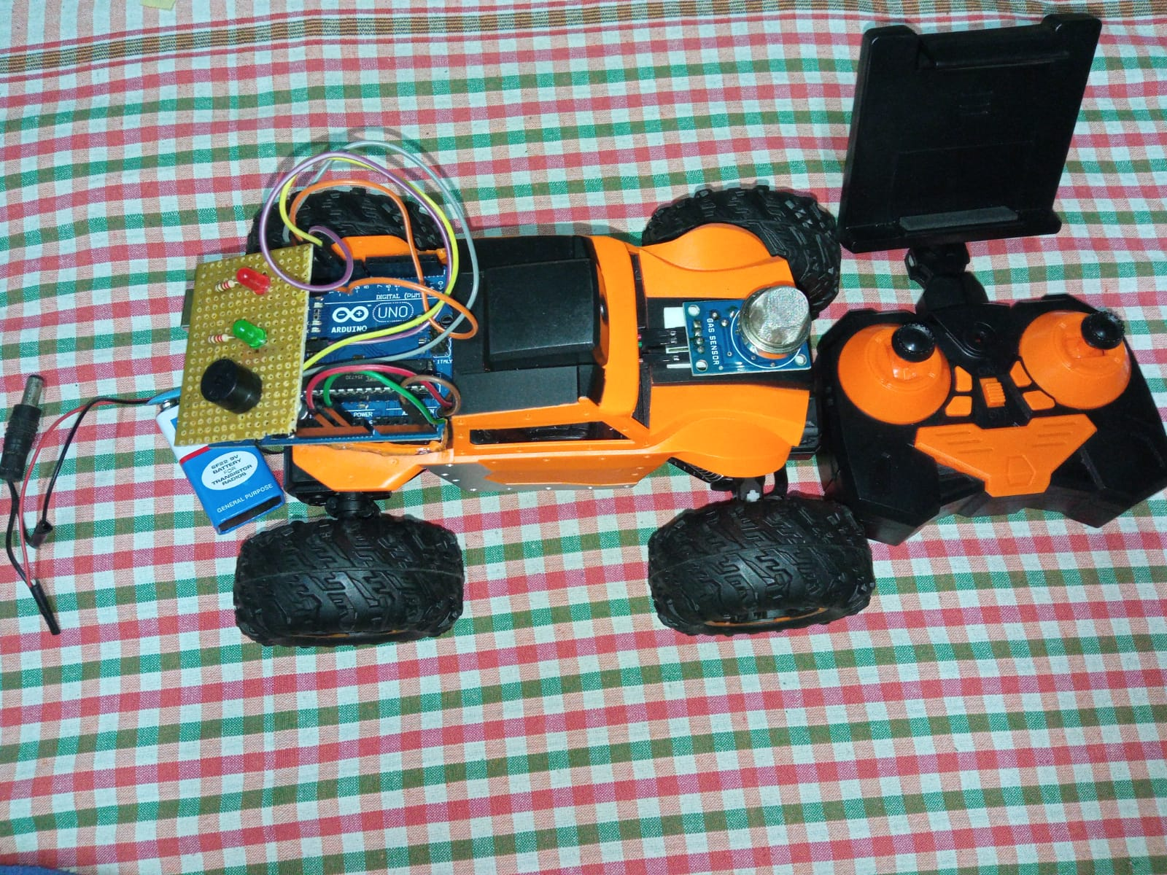

Picture of the Project with label (With neat background)
Chassis
Piezo buzzer
PCB
MQ2
Green LED
Remote controller
Red LED
Arduino UNO
Power supply
https://drive.google.com/file/d/1ECgp5DhMMI2tnRVwFg7fw8Ku6yWnxx5c/view?usp=share_link
Department of Electronics and Communication Engineering

Slide 8
Budget in detail(with components):
S.NO | Components used | Cost
[1]. | Arduino Uno (1) | ₹500
[2]. | PCB | ₹50
[3]. | Jumper wires | ₹100
[4]. | MQ2 gas sensor | ₹100
[5]. | LED’s | ₹20
[6]. | Piezo buzzer | ₹20
[7]. | Batteries and Connector | ₹200
[8]. | Chassis | ₹1500
[9]. | Camera with WIFI module | ₹800
[10]. | RC remote Mobile Holder | ₹80
[11]. | Glue Gunn | ₹250
[12]. | Extra | ₹500
Department of Electronics and Communication Engineering

Slide 9
Conclusion :
By this we are concluding that using our project one can save the life's of people who are working as a fire fighter, mine operator etc., to save themselves from harmful gases instead of gong blindly they can make use of our project to know the conditions which are present in that particular area or a scene they can know what are there using the camera which is present on the ROV and they can check whether there are any kind of harmful gases so that they can take preventive measures.
Outcome of the Project
The outcome of our project is to detect some harmful gases which are present in the air which they breathe we have made a ROV which is an offroad vehicle.
Department of Electronics and Communication Engineering

Slide 10
References(IEEE format)
[1]. https://sci-hub.se/https://ieeexplore.ieee.org/document/8259920
In the above reference link we can see a publication on “The ROV communication and control”.
[2]. https://sci-hub.se/https://ieeexplore.ieee.org/abstract/document/1145191
In the above reference link we can see a publication on “Supervisory Control System for the JASON ROV”.
Department of Electronics and Communication Engineering

